Slide 1



Github
Bat El Peretz
Github SCM introduction for devops

Slide 2
Module introduction
1
3
Understanding Github
Using SSH
2
4
Creating github account
Searching in github

Slide 3


What is Github?
GitHub is a web-based platform that provides hosting for software development version control using Git. It allows developers to collaborate on projects, share code, and track changes to the codebase.
It’s also very popular, official numbers from 2022 say that over 40 million developers, are using github today!

Slide 4
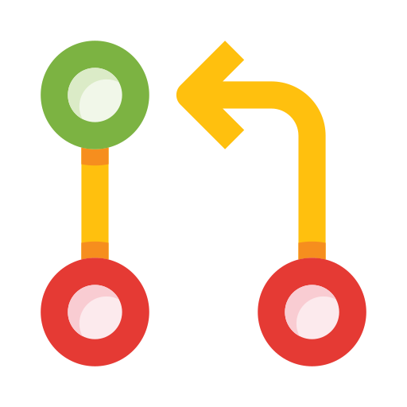
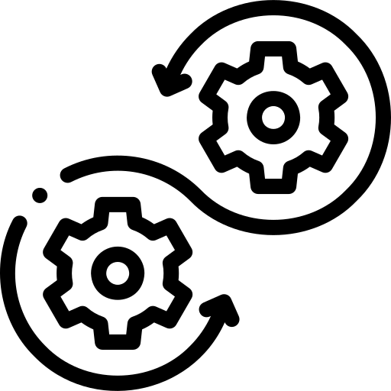
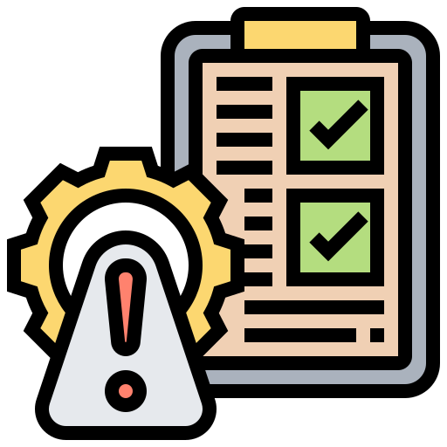
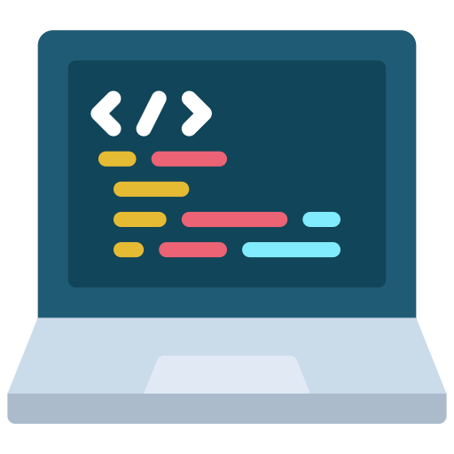
Github main features
Code: All the code lives in repositories
Pull requests: Developers can request, that their changes are pulled to another branch.
Issues: We can work with issues to register work that needs to be done
CI/CD features: Continuous build and deploy features, in the form of github actions.

Slide 5
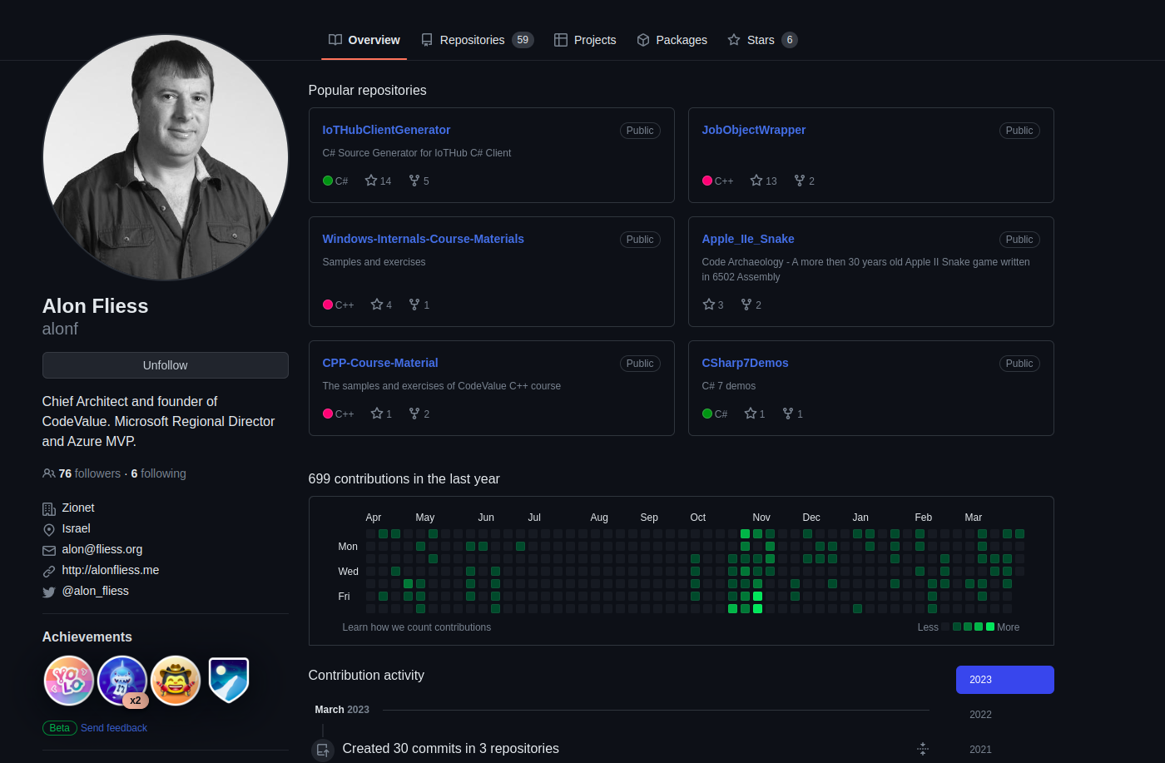
Creating github account
www.github.com -> Sign in -> Create an account
You’ll get personal landing page, and you can edit your profile, change your profile picture, and you can also see your contributions.

Slide 6
Working with SSH
SSH (Secure Shell) is a secure network protocol that allows you to remotely connect to another computer or server. In GitHub, you can use SSH to securely connect to your repositories and perform various actions, such as pushing and pulling code changes.
Here are the steps to generate an SSH key pair:
Open your terminal or command prompt.
Type the command ssh-keygen -t ed25519 -C "your_email@example.com" and press Enter. This will generate a new SSH key pair with the specified email address.
You will be prompted to enter a file name for your SSH key. Press Enter to accept the default name, or specify a custom name if you prefer.
You will also be prompted to enter a passphrase for your SSH key. This is optional, but recommended for added security. You can just press Enter!
Your SSH key pair has been generated! You can now add your public key to your GitHub account. Follow to the next slide :-)

Slide 7
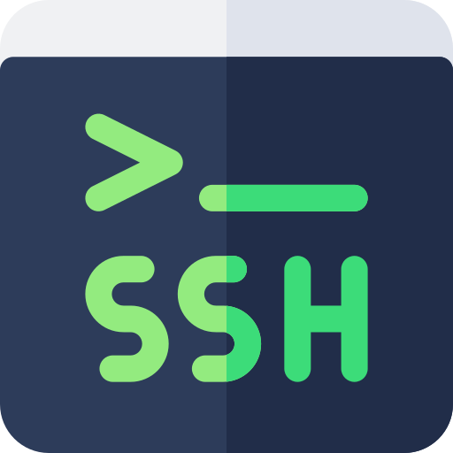
Working with SSH #2
To add your public key to your GitHub account:
Go to your GitHub account settings.
Click on "SSH and GPG keys" in the sidebar.
Click on the "New SSH key" button.
Give your SSH key a title, such as "My SSH key".
Paste your public key into the "Key" field.
Click on the "Add SSH key" button.
You're done! You can now use SSH to connect to your GitHub repositories.

Slide 8
Searching in Github
GitHub has a powerful search feature that allows you to find repositories, code snippets, issues, pull requests, and more.
You can access the search bar by clicking on the magnifying glass icon in the top navigation bar.
Here are some tips for searching in GitHub:
Use keywords: To search for a specific term, enter it into the search bar. You can also use boolean operators (AND, OR, NOT) to refine your search.
Filter by type: You can use the "Type" filter to search for specific types of content, such as repositories, issues, or code.
Filter by language: You can use the "Language" filter to search for repositories written in a specific programming language.
Filter by date: You can use the "Created" or "Updated" filters to search for content created or updated within a specific time frame.
Sort results: You can sort your search results by relevance, stars, forks, or recently updated.

Slide 9
Understanding Repositories
A repository is a collection of files and directories that make up a project. In GitHub, repositories are used to store and manage code.
Each repository has a unique URL, which can be accessed by anyone with the appropriate permissions.
Here are some key concepts to understand about repositories:
Creating a repository: To create a new repository, click on the "New" button in your GitHub dashboard. You can choose to create a new repository from scratch or import an existing repository from another source.
Cloning a repository: To clone a repository, you can use the Git command line interface or a Git client. Cloning a repository creates a local copy of the repository on your computer, which you can then work on and push changes back to the remote repository.

Slide 10
Understanding Repositories #2
Branching: Repositories can have multiple branches, which are essentially separate versions of the code. Branches can be used to develop new features, fix bugs, or experiment with different ideas without affecting the main codebase.
Pull requests: Pull requests are a way to propose changes to a repository. When you make changes to a branch and push them to the remote repository, you can create a pull request to request that your changes be merged into the main codebase.
Collaboration: GitHub repositories are designed for collaboration, allowing multiple people to work on the same project at the same time. You can add collaborators to your repository, set permissions for different users, and use features like issues and pull requests to communicate and coordinate your work.

Slide 11
Github basic terminal commands
Cloning a repository: git clone <repository-url>
Checking the status of a repository: git status
Adding changes to the staging area: git add <file-name>
Committing changes: git commit -m "Commit message"
Pushing changes to the remote repository: git push origin <branch-name>
Creating a new branch: git branch <branch-name>
Switching to a different branch: git checkout <branch-name>
Creating a new branch and switching to it: git checkout -b <new-branch-name>
Fetching updates from the remote repository: git fetch
Pulling updates from the remote repository: git pull
Merging changes from one branch into another: git merge <branch-name>
Viewing the commit history: git log
Discarding changes to a file: git checkout -- <file-name>
Removing a file from the repository: git rm <file-name>
Ignoring files using a .gitignore file: create a file called .gitignore in the root directory of the repository and add the names of files or directories to ignore.
Check your current branch: git branch -a

Slide 12
Adding a README File
A README file is an important part of any GitHub repository. It provides basic information about the project, such as its purpose, features, and how to use it. Here are some steps to create and add a README file to your repository:
Create a new file in your repository called README.md (use .md extension for Markdown formatting).
Add some basic information about your project, such as what it is, why it's useful, and how to get started. You can use Markdown formatting to make your README look more professional and organized.
Include information on how to install and use the project, along with any dependencies or prerequisites. This will help other users get up and running quickly.
If applicable, include information on how to contribute to the project, such as how to report bugs, make feature requests, or submit code changes.
Save the file and commit the changes to your repository.

Slide 13
Adding Collaborators to Your Repository
Collaborating with others is an important part of GitHub. Here are some steps to add collaborators to your repository:
Go to the repository's page on GitHub.
Click the "Settings" tab.
Click "Collaborators & Teams" on the left-hand menu.
Type the username or email address of the person you want to add as a collaborator.
Click "Add Collaborator."
The person you added will receive an email inviting them to collaborate on your repository. They will need to accept the invitation to gain access to the repository.

Slide 14
Repository Insights
GitHub provides a powerful set of analytics tools to help you understand how your repository is being used and identify areas for improvement.
Here are some of the features available through the "Insights" tab:
Traffic: Shows the number of visits and unique visitors to your repository over time. You can see which pages are being visited most frequently and where your visitors are coming from.
Contributors: Shows a list of contributors to your repository and the number of commits they have made. You can also see how many pull requests they have submitted and how many have been merged.
Code frequency: Shows a graph of how often code is being added or removed from your repository. This can help you identify trends in your development process and monitor changes in your codebase.

Slide 15
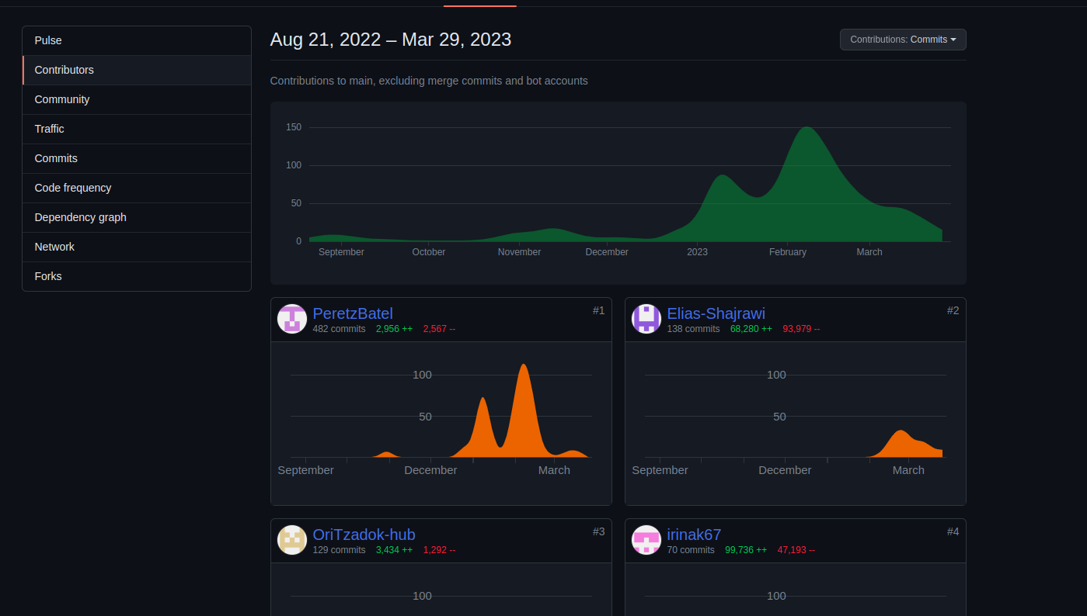
Repository Insights #2
Issues: Shows a graph of the number of open and closed issues in your repository over time. You can also see the average time it takes to close an issue and the distribution of issues across labels.
Pull requests: Shows a graph of the number of open and merged pull requests in your repository over time. You can also see the average time it takes to merge a pull request and the distribution of pull requests across labels.

Slide 16
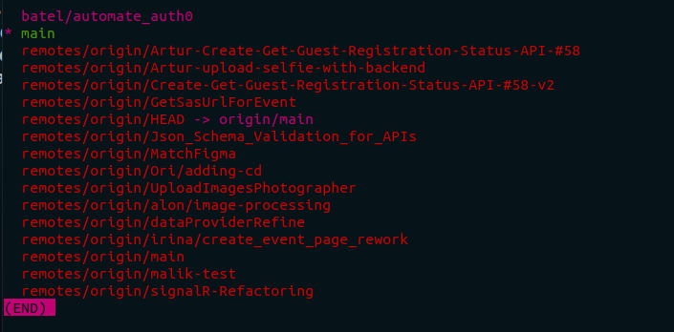
Working with Branches
Branches are a fundamental part of version control systems like Git and GitHub. They allow developers to work on multiple versions of a project at the same time, without affecting the main codebase. When a new branch is created, it is essentially a copy of the original codebase, which can be modified and experimented with without affecting the main codebase. Branches are often used to work on new features or bug fixes in a controlled and isolated manner. Once a branch is complete, its changes can be merged back into the main codebase through a pull request. This allows multiple developers to collaborate on the same codebase without conflicting with each other's work.

Slide 17
Terminal commands for working with branches in GitHub
Creating a new branch: git checkout -b [new-branch-name]
-This creates a new branch and switches to it.
Switching between branches: git checkout [existing-branch-name]
-This switches to an existing branch.
Merging branches: git checkout main - This switches to the main branch.
git merge [branch-to-merge] - This merges changes from the specified branch into the main branch.
Deleting branches: git branch -d [branch-to-delete] This deletes the specified branch

Slide 18
Pull Requests in GitHub
What is a Pull Request?
A pull request is a way for developers to propose changes to a codebase in GitHub.
It allows developers to explain their changes, provide context, and request feedback from other team members.
Once a pull request is created, it can be reviewed, discussed, and commented on by other developers before being merged into the codebase.
How to Create a Pull Request:
Clone the repository:
git clone [repository-url]
Create a new branch to work on changes:
git checkout -b [new-branch-name]
Make changes to the codebase and commit them:
git add .
git commit -m "[commit-message]"
Push the branch to the repository:
git push origin [new-branch-name]
Create a pull request from the branch in the cloned repository to the original repository:
hub pull-request -b [base-branch] -h [head-branch] -m "[pull-request-title]"

Slide 19
Pull Requests in GitHub #2
Pull Request Review Process:
When a pull request is created, other developers can review the proposed changes and leave comments.
The pull request review process allows for collaboration and discussion among team members before changes are merged into the codebase.
The review process can involve checking for bugs, verifying that tests pass, ensuring code meets style guidelines, and discussing overall architecture and design decisions.
Merge the pull request:
git merge [pull-request-branch-name]
Push the changes to the original repository:
git push origin [base-branch]

Slide 20
Merging with Conflicts in GitHub
Sometimes, when you try to merge changes in GitHub, conflicts can occur.
Conflicts happen when two or more branches have made changes to the same lines of code, and GitHub doesn't know which changes to keep.
In this slide, we will discuss how to handle conflicts that arise during the merging process in GitHub.
Understanding Code Conflicts:
A code conflict occurs when changes made in one branch conflict with changes made in another branch.
Conflicts can happen when two or more people are working on the same codebase, and changes are made simultaneously.
Conflicts can also occur when changes made in a branch are based on outdated code in another branch.

Slide 21
How to handle code conflict in github?
Identify the conflicting files:
git status
Open the conflicting file in a text editor:
code [conflicting-file-name]
Search for the conflicting code sections and resolve the conflicts manually.
GitHub will highlight the conflicting sections in the file with <<<<<<, ======, and >>>>>> markers.
Edit the code to resolve the conflicts.
Save the file and stage it for commit:
git add [conflicting-file-name]
Commit the changes with a message:
git commit -m "[commit-message]"
Push the changes to the original repository:
git push origin [base-branch]

Slide 22

Forking Repositories in GitHub
What is a Forked Repository?
A forked repository is a personal copy of another user's repository.
When you fork a repository, you create a new branch that is independent of the original codebase.
You can make changes to the forked repository and push those changes to your forked repository without affecting the original codebase.
How to Fork a Repository:
Navigate to the repository you want to fork in GitHub.
Click the "Fork" button in the top-right corner of the repository page.
Select the account you want to fork the repository to (if you have multiple GitHub accounts).
Wait for the forking process to complete.

Slide 23
Forking Repositories in GitHub #2
How to Work with a Forked Repository:
Clone the forked repository to your local machine:
git clone [forked-repository-url]
Create a new branch to work on changes:
git checkout -b [new-branch-name]
Make changes to the codebase and commit them:
git add .
git commit -m "[commit-message]"
Push the branch to your forked repository:
git push origin [new-branch-name]
Create a pull request to merge your changes into the original repository:
Navigate to your forked repository in GitHub
Click the "New pull request" button
Choose the branch with your changes as the "head branch"
Choose the original repository branch you want to merge your changes into as the "base branch"
Click the "Create pull request" button

Slide 24
Creating Issues in GitHub
What is an Issue?
An issue is a ticket that tracks a task, bug, or feature request in a GitHub repository.
Issues can be assigned to specific people, labeled, and prioritized.
Anyone can create an issue in a GitHub repository, and they can be used to facilitate collaboration and communication among team members.
How to Create an Issue:
Navigate to the repository where you want to create an issue.
Click on the "Issues" tab.
Click the "New issue" button.
Give your issue a descriptive title.
Write a detailed description of the issue, including steps to reproduce the problem (if applicable).
Assign the issue to a specific person, if necessary.
Label the issue with relevant tags, such as "bug" or "enhancement."
Set the priority of the issue using the "Priority" field.
Click the "Submit new issue" button.

Slide 25
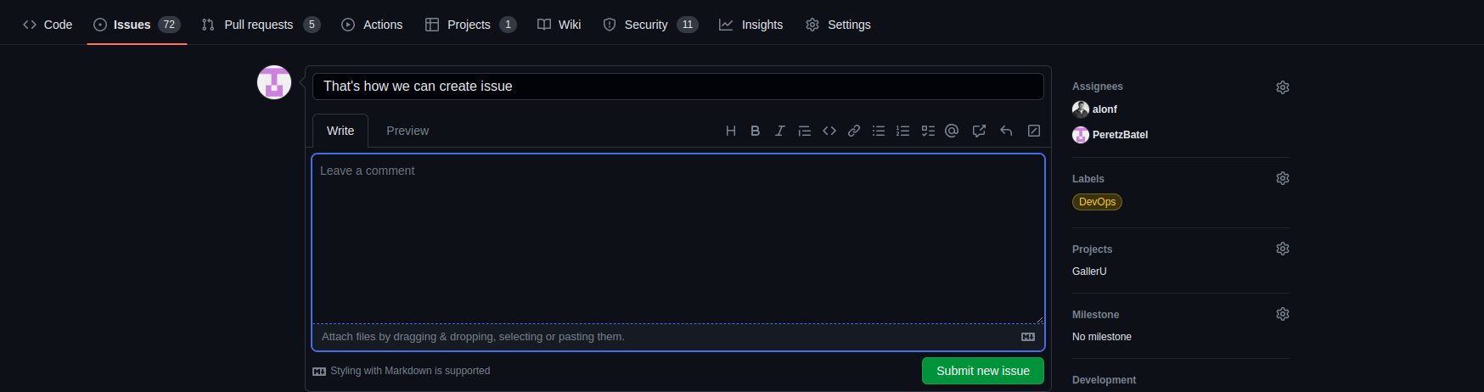
Creating Issues in GitHub #2
Tips for Creating Effective Issues:
Use a descriptive title that clearly summarizes the issue.
Provide detailed information about the problem, including any error messages or steps to reproduce the issue.
Use labels and priority fields to help organize and prioritize issues.
Assign issues to specific people to ensure that they are addressed promptly.
Use the discussion section to communicate with other team members and provide updates on the progress of the issue.

Slide 26
Publishing a Release in GitHub
What is a Release?
A release is a specific version of your code that is ready for distribution.
Releases are used to share code with others, such as a new version of your software or a stable release.
You can add releases to your repository to mark specific milestones or versions.
How to Publish a Release:
Navigate to the repository where you want to publish a release.
Click on the "Releases" tab.
Click the "Draft a new release" button.
Give your release a descriptive title and version number.
Add a detailed description of the release, including any new features or changes.
Choose the commit that you want to tag and include in the release.
Add any relevant assets, such as binaries or documentation.
Click the "Publish release" button.

Slide 27
GitHub Actions
What is GitHub Actions?
GitHub Actions is an automation tool that allows you to build custom workflows for your GitHub repositories.
Workflows are made up of one or more jobs, which are sets of steps that run on a specific runner.
Workflows can be triggered by events, such as a push to a specific branch or the creation of a pull request.
How to Create a Workflow:
Navigate to the repository where you want to create a workflow.
Click on the "Actions" tab.
Click the "New workflow" button.
Choose a template or create a new workflow file from scratch.
Define the trigger events and jobs for the workflow.
Add steps to each job to automate specific tasks.
Test and debug the workflow as needed.
Save and commit the workflow file to your repository.

Slide 28
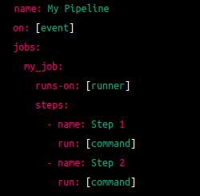
GitHub Actions Pipeline Syntax
GitHub Actions uses a YAML-based syntax to define workflows.
A pipeline in GitHub Actions is defined using the following syntax:
The name field defines the name of the pipeline.
The on field defines the event that triggers the pipeline.
The jobs field defines the jobs that make up the pipeline.
Each job is made up of a runs-on field that defines the runner for the job, and a steps field that defines the steps that make up the job.
Each step is made up of a name field that defines the name of the step, and a run field that defines the command to run for the step.

Slide 29
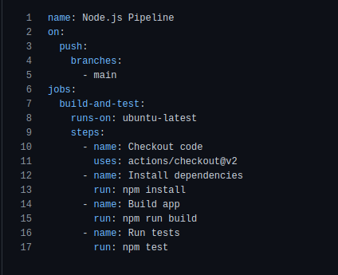
GitHub Actions Pipeline Syntax
Here is an example of a simple pipeline that builds and tests a Node.js application:

Slide 30
GitHub Actions Pipeline Syntax
This pipeline is triggered by a push to the main branch, and consists of a single job that runs on an Ubuntu runner.
The job has four steps: checking out the code, installing dependencies, building the app, and running tests.
Tips for Using GitHub Actions Syntax:
Use indentation and formatting to make your pipelines easy to read and understand.
Use descriptive names for your pipelines, jobs, and steps.
Use the uses field to include actions from the GitHub Marketplace or other repositories.
YAML Lint - A web-based tool that checks YAML syntax and indentation:
https://www.yamllint.com/

Slide 31
Continuous Integration and GitHub Actions
Continuous Integration (CI) is a development practice that involves automatically building, testing, and deploying code changes as they are made.
GitHub Actions is a built-in CI/CD solution that enables developers to automate workflows and improve collaboration on GitHub.
With GitHub Actions, you can create custom workflows that trigger actions based on events, such as pushing code changes, creating pull requests, or even scheduling regular jobs.
These workflows can be used to build, test, and deploy code changes, as well as to perform other tasks like generating documentation or sending notifications.
GitHub Actions provides a wide range of pre-built actions and support for popular programming languages, making it easy to get started with CI/CD even if you're new to automation.
With GitHub Actions, you can also use custom scripts and tools to create more complex workflows that meet your specific needs.
By automating the CI/CD process with GitHub Actions, developers can catch and fix errors more quickly, reduce manual labor, and increase productivity.
Additionally, GitHub Actions enables teams to work together more efficiently by providing a central place to manage code changes and workflows.

Slide 32
Running Multiple Jobs with GitHub Actions
In GitHub Actions, you can run multiple jobs within a single workflow to perform different tasks in parallel or sequentially.
Jobs are defined as individual steps that can be run on different platforms and environments, such as Linux, Windows, or macOS.
Each job can run one or more steps, which are a series of commands or actions that perform a specific task, such as building, testing, or deploying code.
By running multiple jobs in a workflow, you can parallelize tasks and optimize performance, or run tasks sequentially to ensure dependencies are met.
You can also configure jobs to run conditionally based on certain events, variables, or job outputs.
GitHub Actions provides built-in support for matrix builds, which allow you to run the same job with different configurations or variables, such as different operating systems, versions, or environments.
Additionally, you can use the needs syntax to define dependencies between jobs, so that one job can only run after another job has completed successfully.
By running multiple jobs in a single workflow, you can streamline your CI/CD process and reduce the time and effort required to build, test, and deploy code changes.

Slide 33
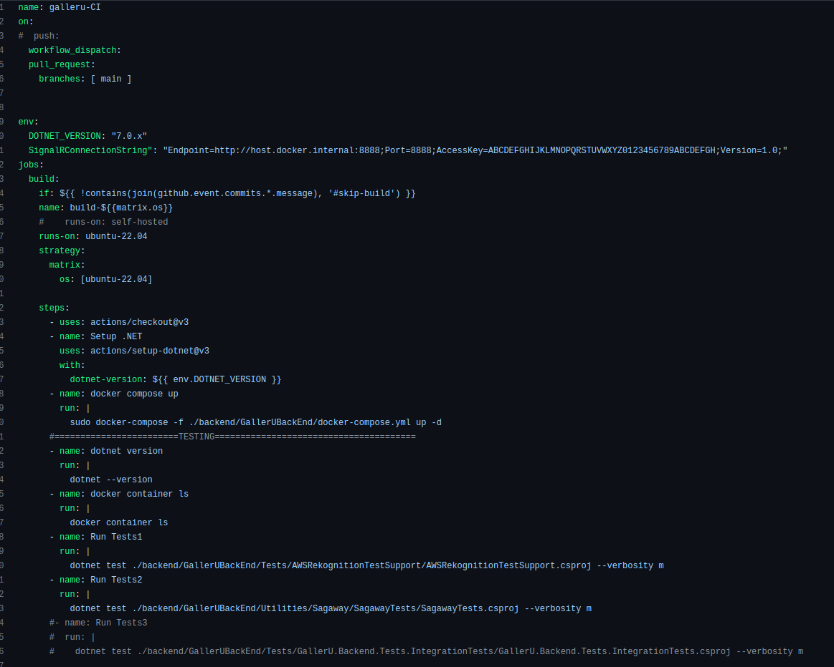
‘Real’ Pipeline example

Slide 34
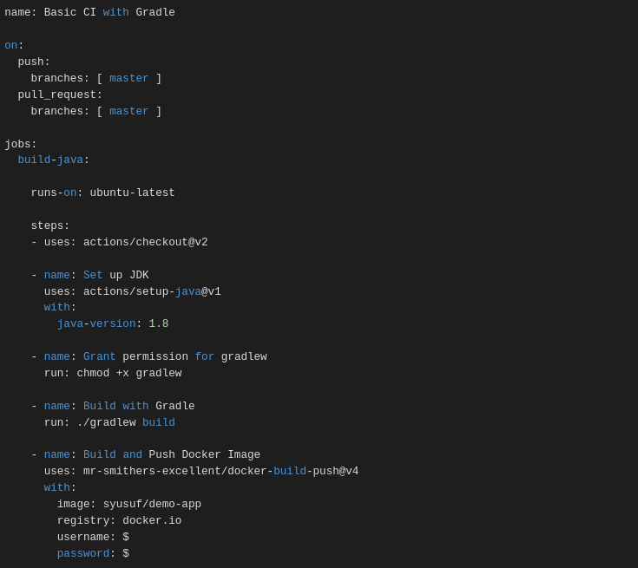
‘Real’ Pipeline example #2

Slide 35
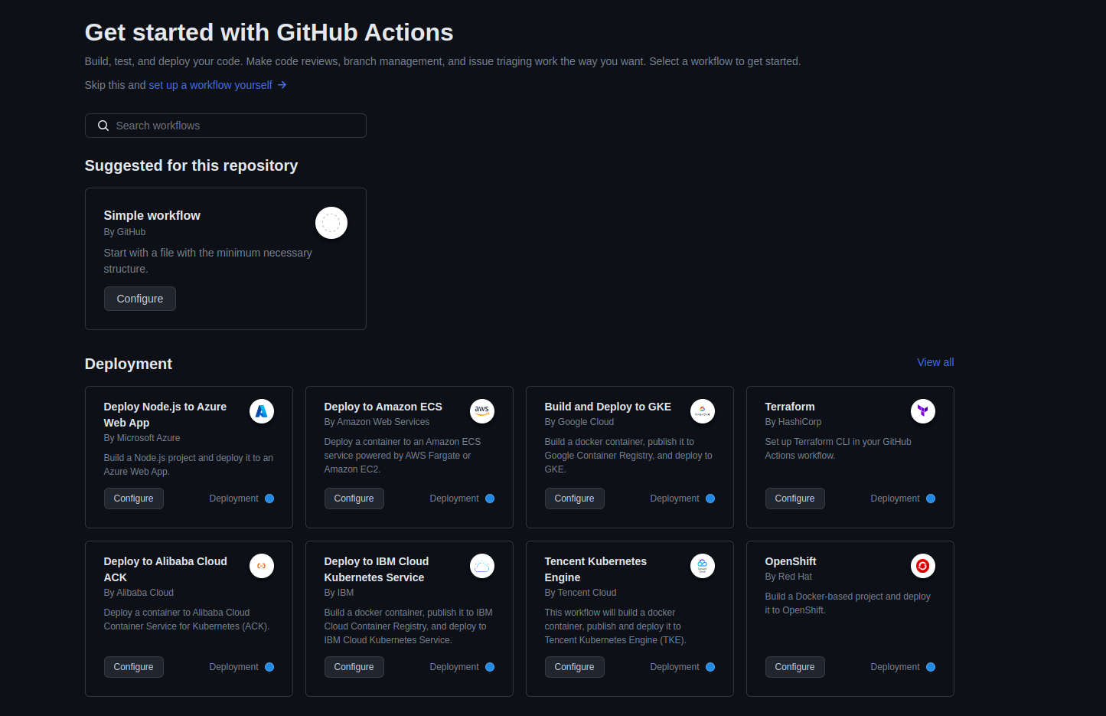
GitHub Actions

Slide 36
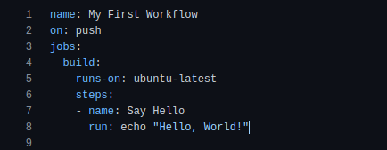
Creating Your First Workflow in GitHub Actions
Exercise:
In this exercise, we will create a simple workflow that prints "Hello, World!" to the console when triggered by a push event.
Steps:
Navigate to your repository in GitHub.
Click on the "Actions" tab.
Click the "New workflow" button.
Choose a template or create a new workflow file from scratch.
Replace the contents of the workflow file with the following code:

Slide 37
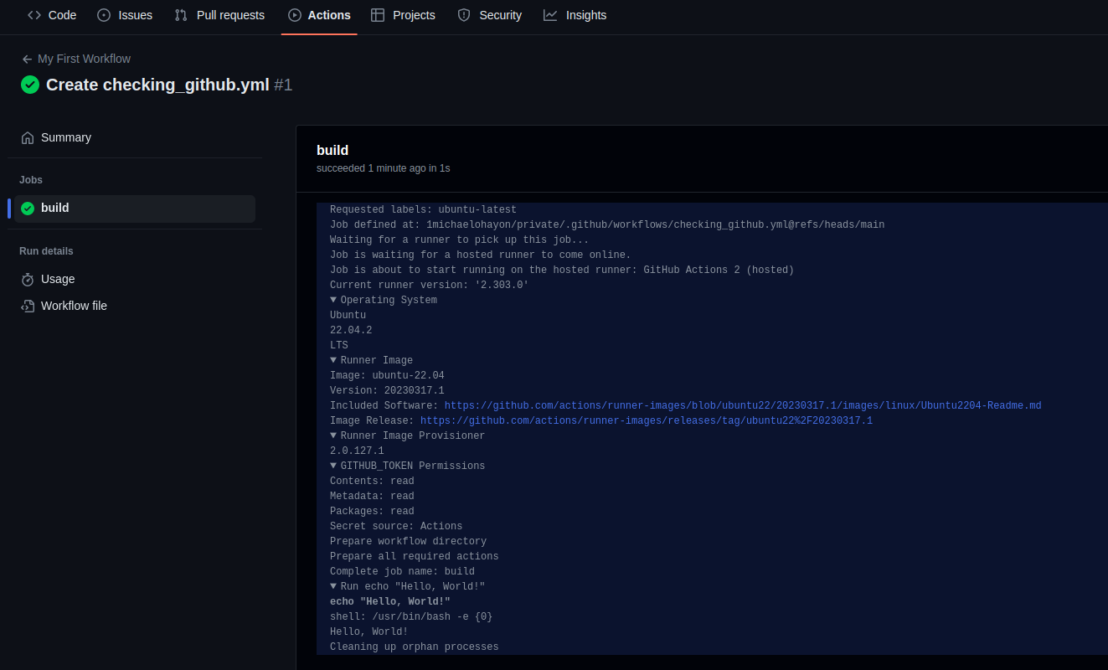
Creating Your First Workflow in GitHub Actions #2
Save and commit the workflow file to your repository.
Trigger the workflow by pushing a change to your repository.
Check the output of the workflow to see the "Hello, World!" message in the console.

Slide 38
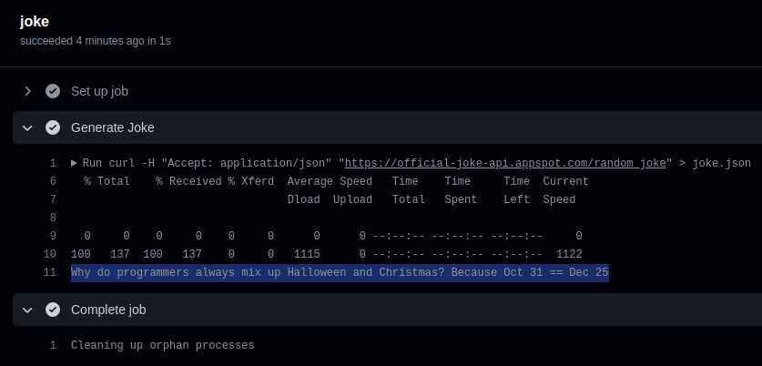
Workflow Exercises!
Create a new repository in GitHub.
Create a workflow that runs on a schedule, for example, once a day or once a week.
The workflow can simply print a message to the console or create an empty file in the repository.
Verify that the workflow runs on schedule by checking the workflow logs in GitHub.
Create a new GitHub repository.
Set up a pipeline using GitHub Actions or a similar tool that generates a random joke or pun and posts it as a comment on a specific issue in the repository.
Configure the pipeline to run on a schedule, such as once a day or once a week.
To generate the random joke or pun, you can use a third-party API like the JokeAPI (https://jokeapi.dev/) or create your own script that generates a random joke or pun.
To test the pipeline, add the ‘workflow_dispatch’ option to run it manually.
Check the output of the pipeline.

Slide 39
Workflow Exercises! -output

